Slide 1
HARPURSVILLE CENTRAL SCHOOL DISTRICT
Public Hearing for February 23rd Project Vote
2/8/2023

Slide 2
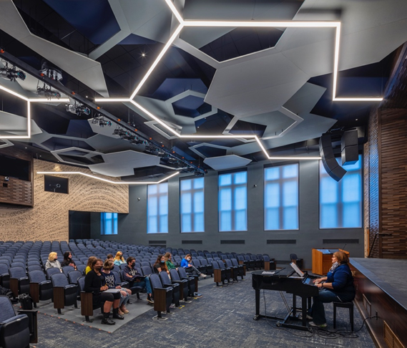
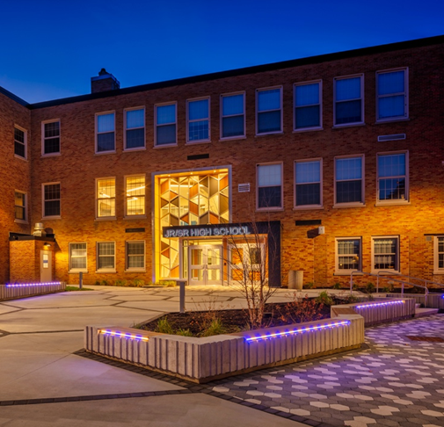
Why a Capital Project
2019 Capital Project – Phase 1
Improved the safety and security of our schools, increased our Hornets pride, updated major building systems in both buildings, and addressed critical infrastructure items.
At that time, we referenced a future project to address items to significantly enhance our school campus.

Slide 3
Why a Capital Project?
Parking lot and pedestrian safety
Providing top-notch facilities for our students and community (multi-purpose turf athletic field, new track, and improved softball field)
Enhance parking areas, safer traffic flows, sidewalks, and lighting
New transportation facility (on-campus)
A much more inviting, attractive, and safe campus plan

Slide 4
Proposed Scope of Work
PROPOSITION #1
PROPOSITION #2
Main Project Scope Items
Demolition of Existing Bus Garage
New Transportation Facility
Campus Circulation
Renovated Softball Field
Relocated Tennis Court
Relocation of Discus and Shot Put Pads
Addition of sideline fencing at Baseball field
New Half-Court Basketball Court
Replacement of OES & HS Sewage Pumps
Main Project Scope Items
Replacement of Running Track & Artificial Turf
Supporting Interior HS Scope Items
Exterior Door Replacement
Supporting Interior OES Scope Items
Exterior Door Replacement
*Proposition 1 must be approved for Proposition 2 to be eligible for approval
Supporting Interior HS Scope Items
Renovation of Main Bathroom Cores
Supporting Interior OES Scope Items
Exterior Door Replacement

Slide 5
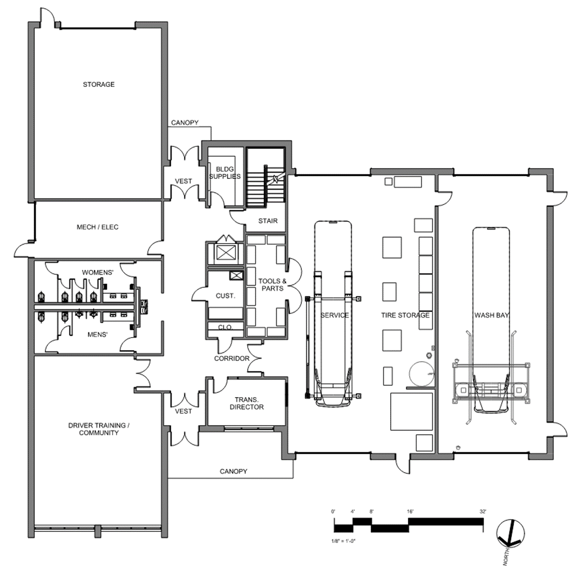
Concept Bus Garage Floor Plan

Slide 6
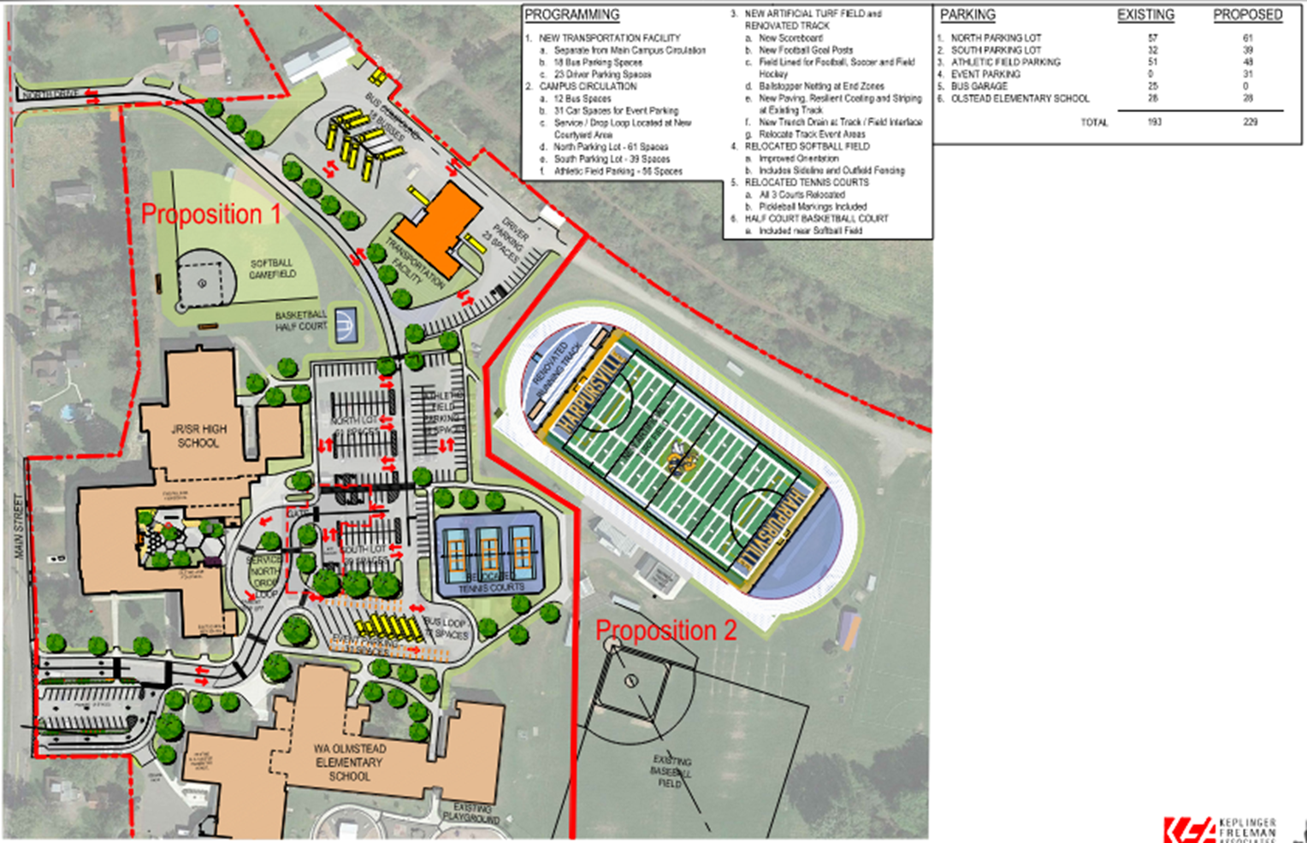
Proposed Overall Master Plan

Slide 7
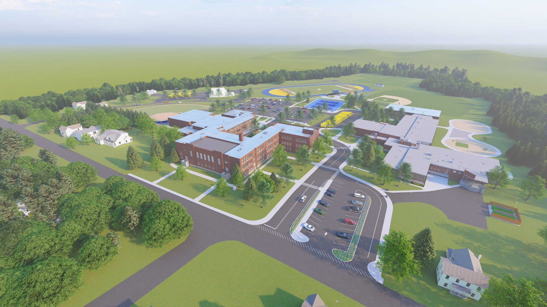

Slide 8
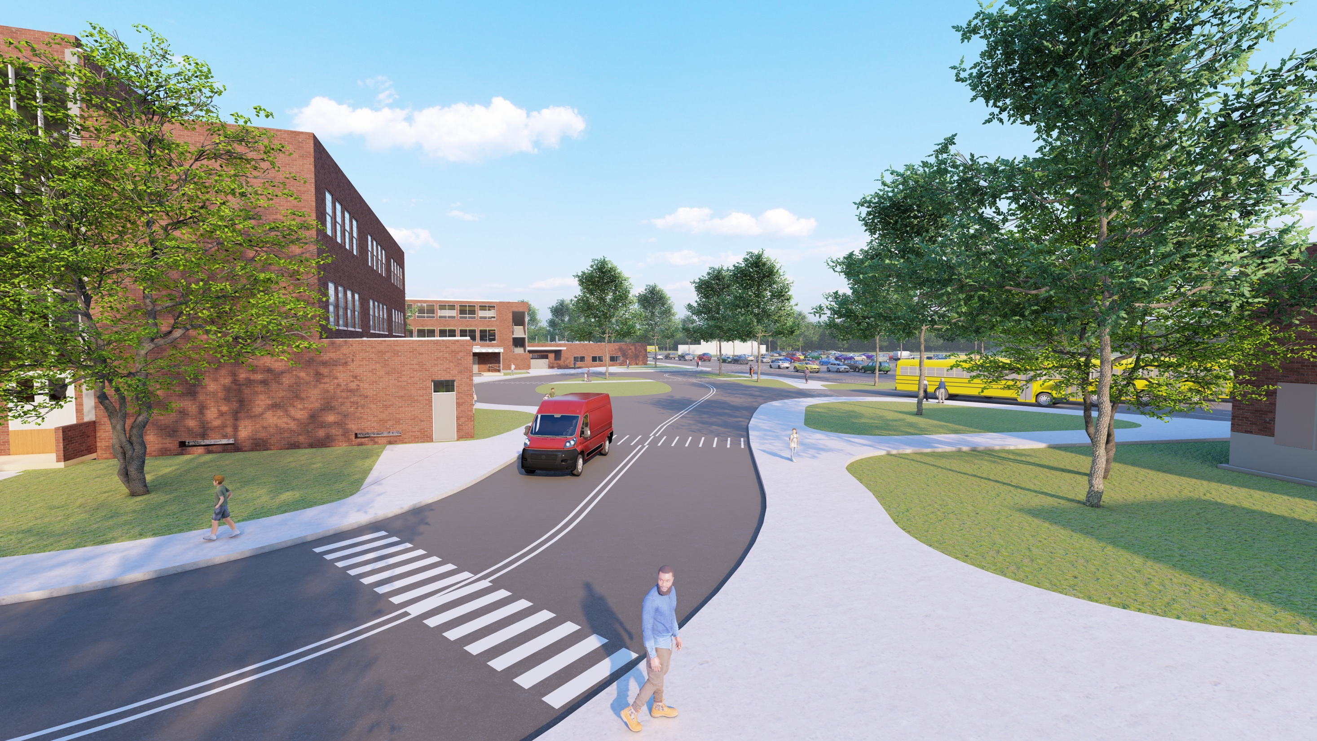

Slide 9
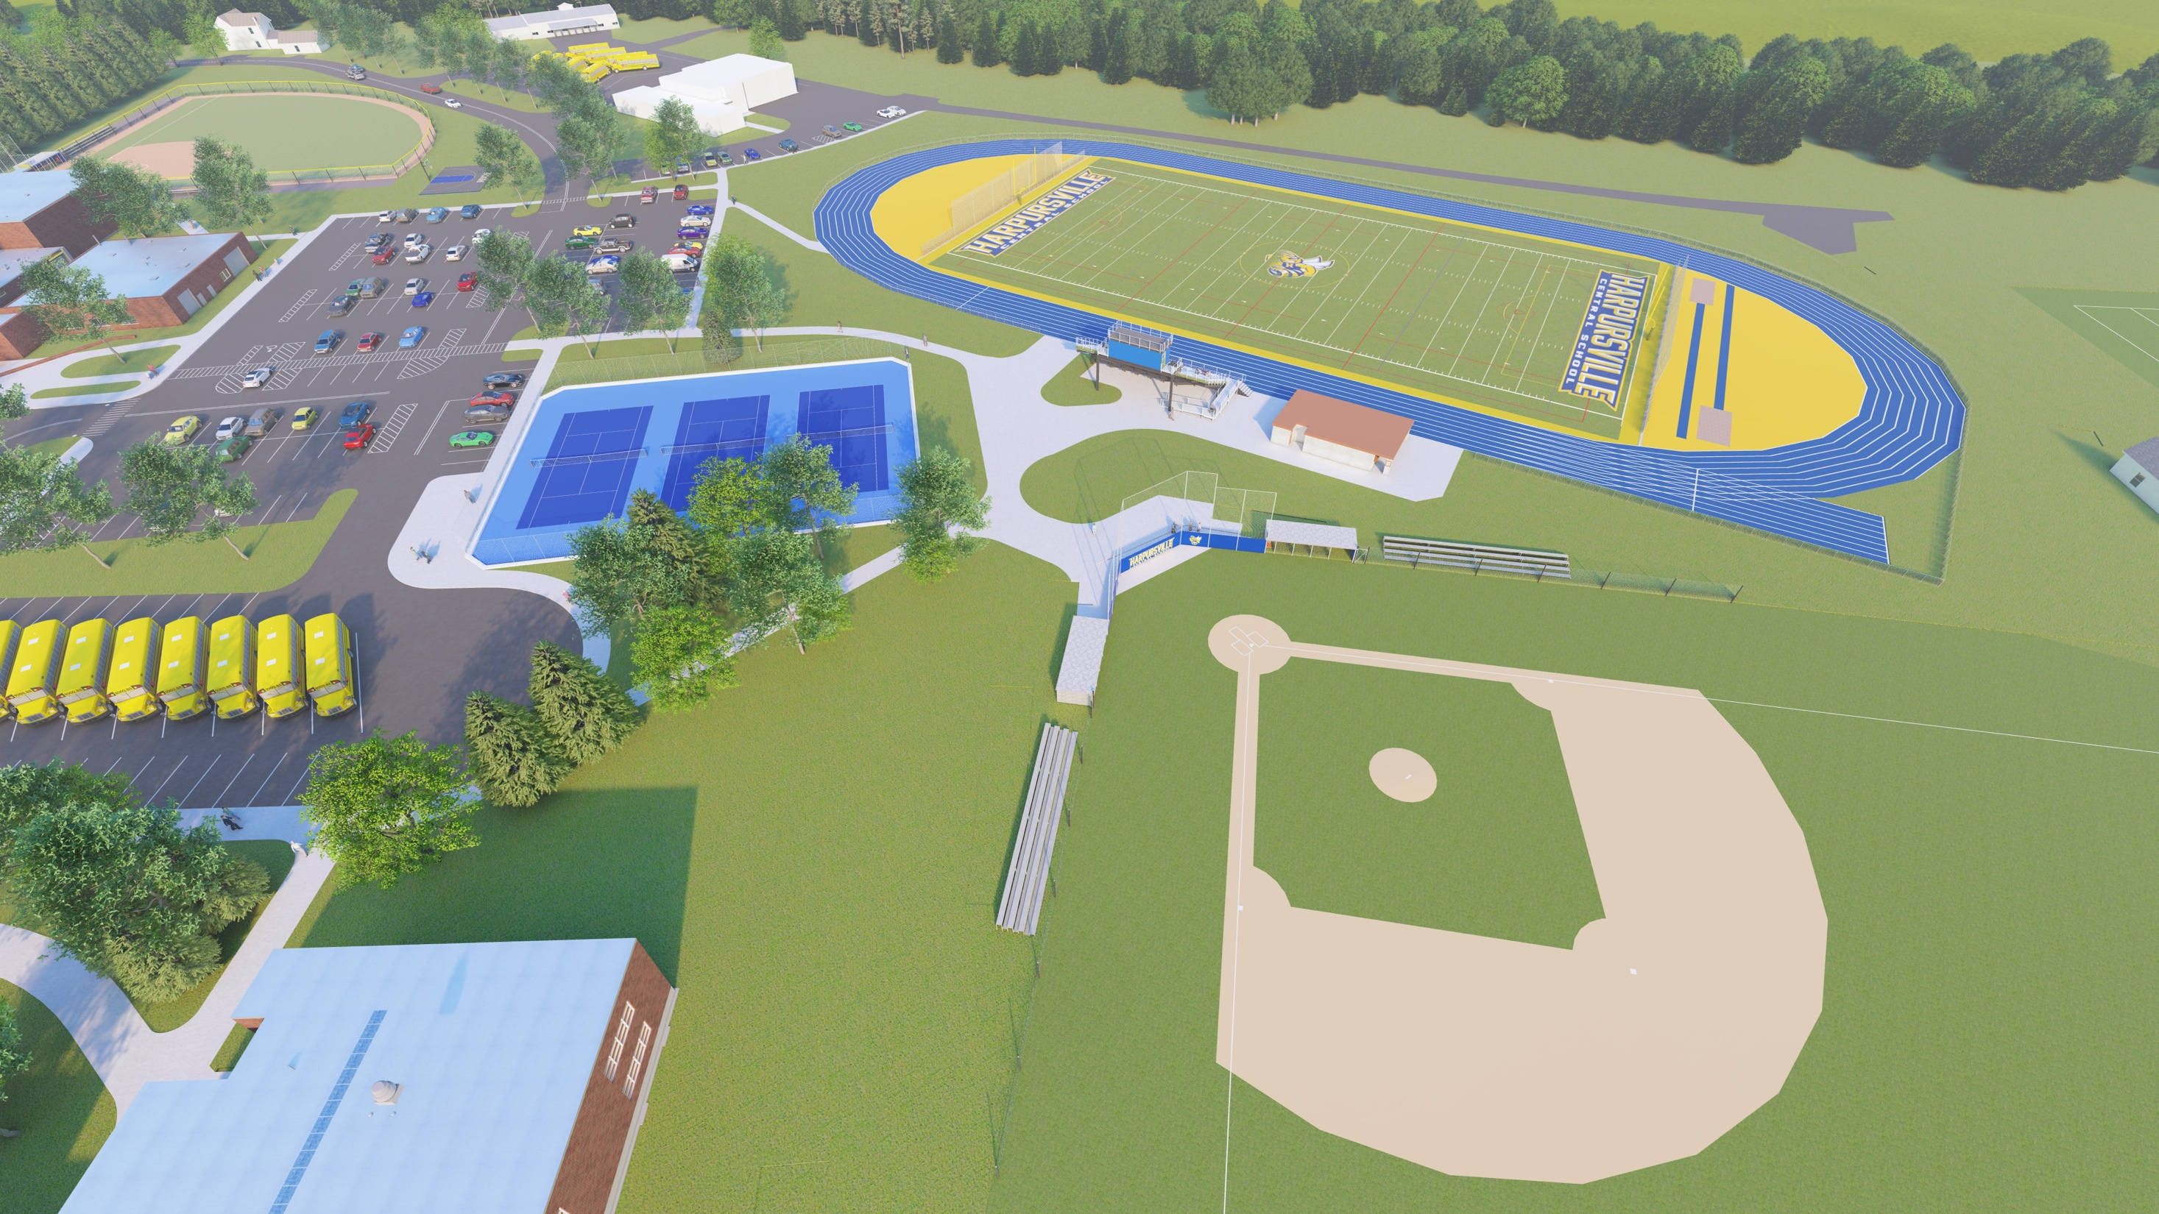

Slide 10
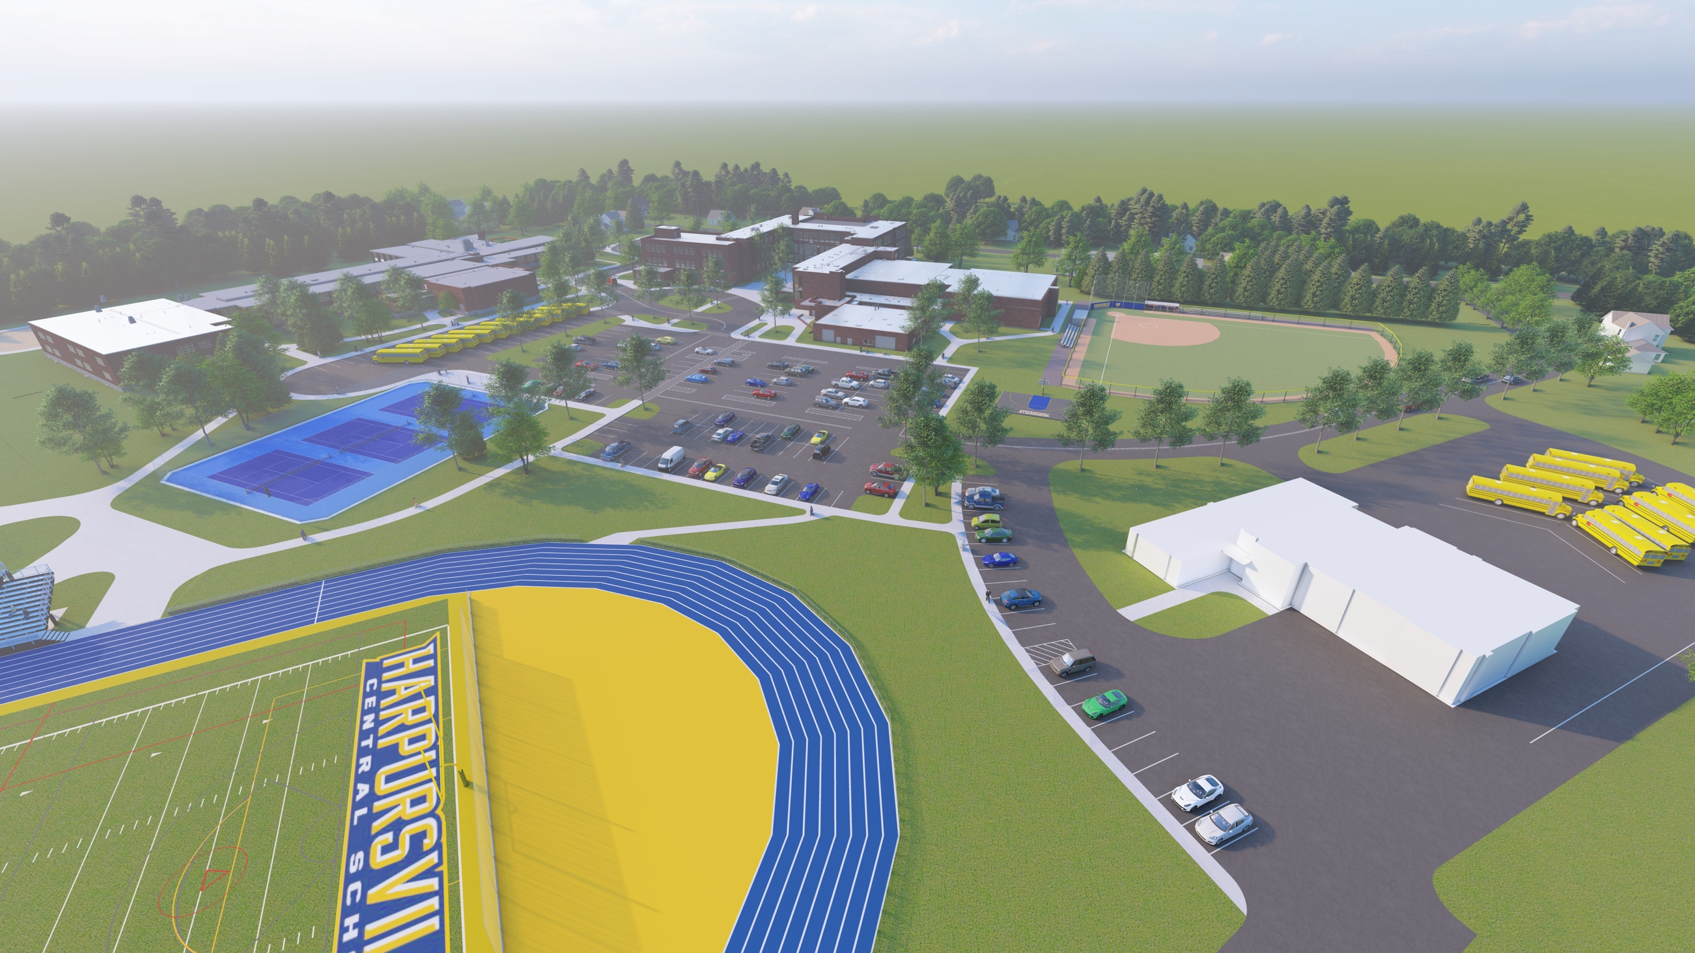

Slide 11
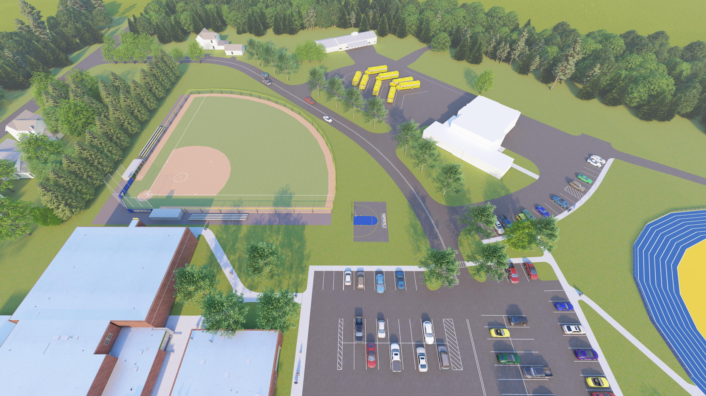

Slide 12
Proposed Project Cost Summary
Project Summary (Total Project Costs)
Building | Proposition 1 | Proposition 2
Jr/Sr HS | $2,700,935 | $1,680,869
OES | $1,514,533 | $2,187,331
BG | $9,530,763 | -
Totals | $13,746,231 | $3,868,200

Slide 13
Capital Project Finances
PROPOSITION 1:
Total Project Cost: $13,746,232
Capital Reserve Used: $3,307,656
Building Aid Ratio: 91.20%
Percentage of Project Eligible for Building Aid: 95%
Term of Building Aid Payback:
15 Years for the Jr./Sr. High and OES (reconstruction)
30 Years for the Transportation Facility (new construction)
PROPOSITION 2:
Total Project Cost: $3,868,200
Capital Reserve Used: $890,000
Building Aid Ratio: 91.2%
Percentage of Project Eligible for Building Aid: 87.6%
Term of Building Aid Payback:
15 Years for the Jr./Sr. High and OES (reconstruction)

Slide 14
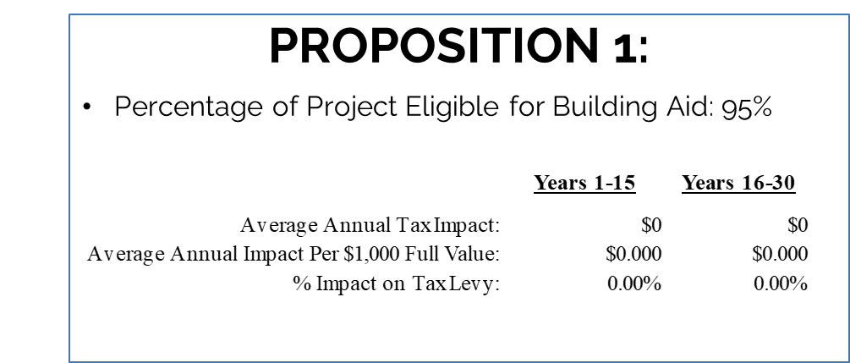
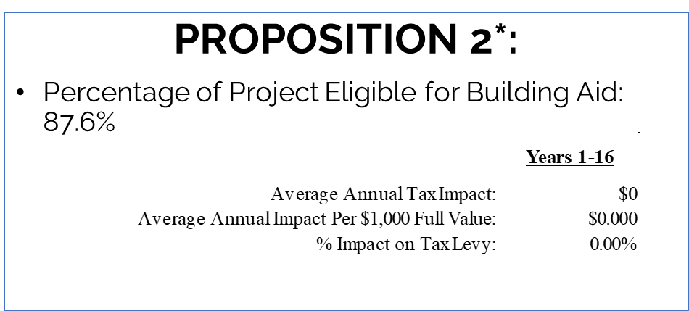
Capital Project Finances

Slide 15
Why does the Proposition language state “raised by the levy of a tax…?
While the propositions state “raised by the levy of a tax...” the project will have no additional tax impact.
The District must bond the project and by strategically timing the payments of this capital project along with NYS building aid and other financial strategies, we are avoiding a tax impact.

Slide 16
Proposed Project Schedule
11/16/22 – BOE Presentation
12/14/22 – BOE & SEQRA Resolution Declaration
2/8/23 – Public Hearing
2/23/23 – Vote
3/1/23 – 11/1/23 – Design Phase
Early November 2023 – SED submission
Late January / Early February 2024 – Bidding
May 2024 – Begin Construction

Slide 17
REMEMBER TO VOTE
Thursday, February 23
1:30 p.m. – 8:00 p.m.
W.A. Olmsted Elementary School – New Gym

Slide 18
Thank You!

